Slide 1
Telco Customer Churn Analysis
Business Analytics Case Study
PRESENTED BY MERIT BARNABAS

Slide 2
Business Problem
Customer churn is one of the biggest challenges facing telecom companies. Acquiring a new customer costs significantly more than retaining an existing one. Understanding why customers leave enables the company to design targeted retention strategies and increase revenue.
Business Questions
Why are customers leaving?
Which customers are most likely to churn?
What factors drive churn?
What actions can reduce churn?

Slide 3


Dataset Overview
The Telco Customer Churn dataset contains information about telecom customers, including their demographics, services, contract details, billing information, and churn status. The analysis aims to identify the factors that influence customer churn and provide insights to improve customer retention.
Dataset Summary
Metric | Value
Total Customers | 7,043
Churned Customers | 1,869
Churn Rate | 26.54%
Average Monthly Charge | 64.76
Average Customer Tenure | 32.37 months

Slide 4
Dataset Variables
The dataset consists of the following categories:
Customer Demographics
Gender
Senior Citizen
Partner
Dependents
Services Used
Phone Service
Multiple Lines
Internet Service
Online Security
Online Backup
Device Protection
Tech Support
Streaming TV
Streaming Movies
Account Information
Tenure
Contract Type
Paperless Billing
Payment Method
Billing Information
Monthly Charges
Total Charges
Target Variable
Churn (Yes or No)
The Churn variable is the target variable because it indicates whether a customer stayed with the company or left.
DATA PREPARATION
Checked data quality
Created tenure groups
Created monthly charge Groups
Created correlation heatmap

Slide 5
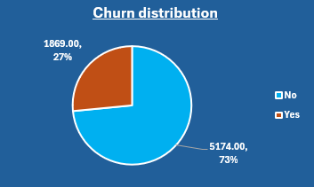
Customer Churn Overview
Key findings
Out of 7,043 customers, 1,869 left the company.
The overall customer churn rate is 26.54%.
About 3 out of every 4 customers stayed with the company.
Although most customers remain, the churn rate is high enough to affect business growth and revenue.
Business Insight
More than one in four customers have left the company. This indicates a significant customer retention challenge and highlights the need to understand the factors driving churn.
This chart shows the overall churn distribution. Out of 7,043 customers, 1,869 left the company, while 5,174 remained. This represents a churn rate of 26.54%, meaning that more than one out of every four customers has left. This level of churn can reduce revenue and increase customer acquisition costs, making retention an important business priority."

Slide 6
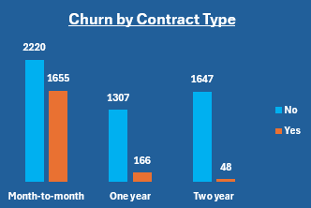
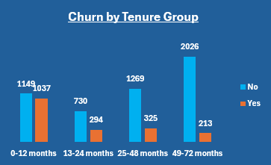
Key Drivers of Customer Churn
Churn by Contract type
Key Finding
Customers with month-to-month contracts have the highest churn.
Customers with one-year and two-year contracts are more likely to stay.
Business Insight Customers without long-term contracts can easily switch to another telecom provider. Longer contracts encourage customer loyalty and reduce churn.
Churn by Tenure Group
Key Finding
Customers with short tenure are more likely to churn.
Customers who have stayed with the company for a longer time are less likely to leave.
Business Insight The first few months are the most important for retaining customers. Providing excellent service and support during this period can improve customer loyalty
Overall Insight :
Contract type and customer tenure are two of the strongest factors influencing churn. Customers on month-to-month contracts and those with shorter tenure are at the highest risk of leaving the company.

Slide 7
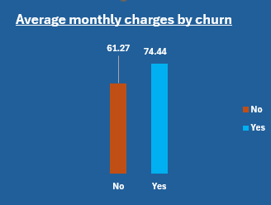
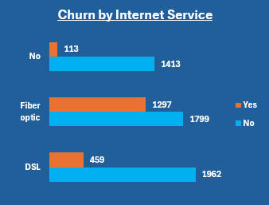
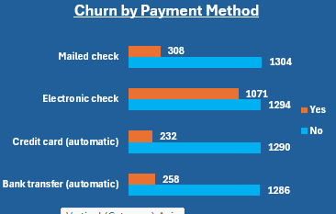
Key Drivers of Customer Churn
Monthly Charges vs Churn
Key Finding
Customers with higher monthly charges are more likely to churn than those with lower monthly charges.
Business Insight
Higher service costs may reduce customer satisfaction, especially if customers feel they are not receiving enough value for the price they pay.
Internet Service vs Churn
Key Finding
Customers using Fibre Optic internet have a higher churn rate than customers using DSL or those without internet service.
Business Insight
This suggests that Fiber Optic customers may be experiencing issues related to pricing, service quality, or unmet expectations. The company should investigate customer feedback and improve the Fiber Optic experience.
Payment Method vs Churn
Key Finding
Customers who pay using Electronic Check have the highest churn rate, while customers using automatic payment methods are less likely to leave.
Business Insight
Automatic payment methods may improve customer convenience and strengthen long-term customer relationships. Encouraging customers to switch to automatic payments could help reduce churn.
Overall Insight :
Monthly charges, internet service, and payment method all influence customer churn. Customers paying higher monthly charges, using Fiber Optic services, or paying by electronic check are at greater risk of leaving the company.

Slide 8
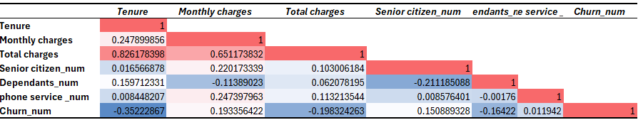
Customer Churn Correlation Analysis
Key Factors Associated with Customer Churn
Tenure has the strongest relationship with churn (r = -0.352), indicating that long-term customers are less likely to leave.
Monthly Charges show a weak positive correlation with churn (r = 0.193), suggesting customers with higher monthly bills are slightly more likely to churn.
Total Charges are strongly correlated with Tenure (r = 0.826), as customers who stay longer accumulate higher charges.
Dependents have a weak negative relationship with churn (r = -0.164), indicating they are slightly less likely to leave.
CORRELATION HEATMAP
Overall Insight: Most variables have weak correlations with churn, suggesting that customer churn is influenced by multiple factors rather than a single variable.

Slide 9
RECOMMENDATION
1. Promote Long-Term Contracts
Customers on month-to-month contracts are most likely to churn.
Recommendation:
Encourage customers to switch to one-year or two-year contracts
Offer discounts or special benefits for long-term commitments
Expected Impact: Improves customer loyalty and reduces the likelihood of customers leaving.
2. Improve Early Customer Experience
Customers with low tenure are more likely to churn.
Recommendation:
Strengthen onboarding processes for new customers
Provide better support during the first 3–6 months
Offer welcome benefits or tutorials for new users
Expected Impact: Increases customer satisfaction during the critical early stage and improves retention.

Slide 10
RECOMMENDATION
3. Review Pricing Strategy
Customers with high monthly charges tend to churn more.
Recommendation:
Review pricing structure for fairness and competitiveness
Offer bundled packages for better value
Expected Impact: Reduces price-related dissatisfaction and improves perceived value.
4. Improve Fiber Optic Service Experience
Fibre Optic users show higher churn rates.
Recommendation:
Investigate service quality issues (speed, downtime, support)
Collect customer feedback specifically from Fiber Optic users
Expected Impact: Improves satisfaction among high-value customers using Fiber Optic services.
5. Encourage Automatic Payment Methods
Customers using electronic check have higher churn.
Recommendation:
Promote automatic payment options (credit card, bank transfer)
Expected Impact: Improves payment consistency and strengthens customer retention.

Slide 11
Conclusion
The analysis of the Telco Customer Churn dataset shows that customer churn is significantly influenced by:
Contract type
Tenure
Monthly charges
Internet service type
Payment method.
Final Insight
To reduce churn, the company must focus on improving customer retention strategies, especially for new customers, high-paying customers, and those on flexible contracts.
By implementing the recommended strategies, the company can improve customer satisfaction, reduce churn, and increase long-term revenue stability.

